Slide 1

VIRTUAL INTELLIGENCE DIRECTORATE
OMNIA VINCENT SAPIENTIA
Enemy Air Assets in Kola
INTREP VID-OPAC-001
DISCLAIMER:
This is for multiplayer online gaming using the Digital Combat Systems simulation software published by Eagle Dynamics. The information is not in any way suitable for real world use or operations.
Version: 1.0
Published: 2024-11-14

Slide 2
INTRODUCTION
A
A
Aim:
This report intends to present information on Notia and Kambiland air assets, organization and locations. Second part of the report intend to present information about their capability.
Reference:
-INTREP VID B-002 Generic Air Force Structure v1.0
INTREP VID OPAT-002 Notia IADS
INTREP VID OPAT-003 Kambiland IADS
Content:
Organization
Squadron locations
Doctrine
Command and Control
Other critical targets
Mission type capability
B
B
C
C
D
D
E
E
F
F

Slide 3





Organization
A
A
B
B
C
C
Socialist Republic of Notia (SRN) Airforce
D
D
E
E
Socialist Republic of Notia (SRN) Naval Aviation
F
F
Democratic Republic of Kambiland (DRK) Airforce
Back

Slide 4
Organization
SRN AF
60th Air Division
A-A role
70th Air Divison
A-G role
80th Support Division
Support role
1st Fighter Aviation Regiment (MiG-29)
2nd Fighter Aviation Regiment (SU-27)
3rd Interceptor Aviation Regiment (MiG-31)
621st Interceptor Squadron
622nd Interceptor Squadron
611th Fighter Squadron
612th Fighter Squadron
613th Fighter Squadron
601st Fighter Squadron
602nd Fighter Squadron
603rd Fighter Squadron
A
A
B
B
C
C
D
D
E
E
F
F
Back

Slide 5
Organization
SRN AF
60th Air Division
A-A role
70th Air Divison
A-G role
80th Support Division
Support role
4th Fighter Aviation Regiment (SU-30)
5th Assault Aviation Regiment (MiG-29S)
6th Assault Aviation Regiment (SU-34)
7th Bomber Regiment (SU-24)
8th Heavy Bomber Regiment (TU-22)
701st Fighter Squadron
702nd Fighter Squadron
711th Assault Aviation Squadron
712th Assault Aviation Squadron
721st Assault Aviation Squadron
722nd Assault Aviation Squadron
731st Bomber Squadron
732nd Bomber Squadron
741st Heavy Bomber Squadron
742nd Heavy Bomber Squadron
743rd Heavy Bomber Squadron
9th Heavy Bomber Regiment
751st Heavy Bomber Squadron (TU160)
752nd Heavy Bomber Squadron (TU95)
A
A
B
B
C
C
D
D
E
E
F
F
Back

Slide 6
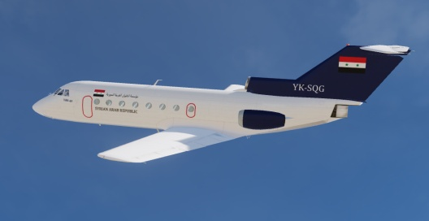
Organization
SYR AF
60th Air Division
A-A role
70th Air Divison
A-G role
80th Air Support Division
Support role
9th Transport Aviation Regiment
811th Transport Squadron (YAK-40)
801st Transport Squadron (IL76)
802nd Transport Squadron (IL-76)
803rd Transport Squadron (AN-26B)
8th AEW Regiment (A-50)
821st AEW Squadron (A-50)
822nd AEW Squadron (A-50)
831st Tanker Squadron (IL-78)
A
A
B
B
C
C
D
D
E
E
F
F
Back

Slide 7
Organization
SRN Naval Aviation
40th Composite Maritime Aviation Division
45th Naval Fighter Regiment
46th Maritime Strike Regiment
451st Fighter Squadron (SU-30)
452nd Fighter Squadron (SU-30)
47th Maritime Patrol Regiment
471st Maritime Patrol Squadron (TU-142)
472nd Maritime Patrol Squadron (TU-142)
461th Maritime Strike Squadron (SU-34)
462nd Maritime Strike Squadron (SU-34)
A
A
B
B
C
C
D
D
E
E
F
F
Back

Slide 8
Organization
DRK AF
30th Fighter Division
311st Fighter Squadron
312nd Interceptor Squadron
A
A
B
B
C
C
D
D
E
E
F
F
Back

Slide 9

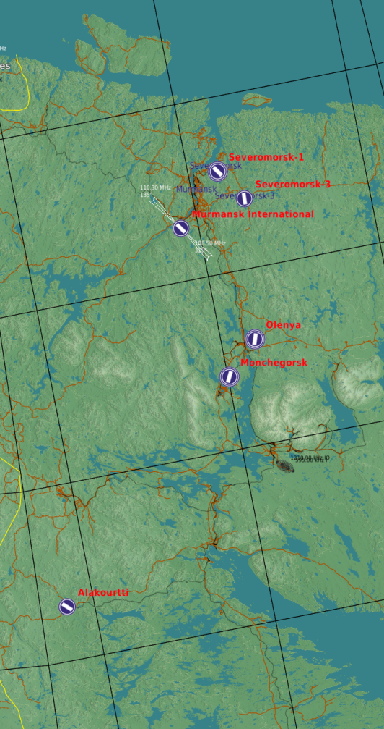

Squadron locations
ALEPPO INTL
KUWEIRES AB
LEGEND:
JIRAH AB
SEVEROMORSK 3
MiG-29 SQN (601)
A
A
60th Division (A-A)
SEVEROMORSK 1
MIG-29S SQN (711)
MIG-29SSQN (712)
B
B
70th Division (A-G)
A-50 SQN (822)
SU-34 SQN (721)
SU-30 SQN (452)
SU-24 SQN (731)
TABQA AB
C
C
80th Division (Support)
SU-30 SQN (451)
MiG-25 SQN (621)
SU-34 SQN (461)
MiG-31 SQN (621)
D
D
40th Division (Maritime)
SU-27 SQN (612)
MiG-29 SQN (711)
SU-24 SQN (731)
SU-34 SQN (462)
TIYAS AB
E
E
30th Division (DRK)
TU-142 SQN (471)
MiG-29 SQN (601)
MiG-29 SQN (602)
TU-142 SQN (472)
MiG-29 SQN (712)
F
F
OLENYA
AN NASIRIYAH AB
TU-22 SQN (741)
TU-22 SQN (742)
TU-22 SQN (743)
MiG-29 SQN (721)
MiG-29 SQN (722)
MURMANSK
SU-27 SQN (611)
TU-160 SQN (751)
MiG-25 SQN (622)
AL DUMARY MIL
IL-76 SQN (801)
TU-95 SQN (752)
MiG-21 SQN (741)
IL-76 SQN (802)
MONCHEGORSK
A-50 SQN (821)
AN-26B SQN (802)
AN-26B SQN (803)
SU-30 SQN (701)
SU-30 SQN (702)
MiG-31 SQN (621)
YAK-40 SQN (811)
IL-78 SQN (831)
SU-27 SQN (613)
KHALKHALAH AB
YAK-40 SQN (811)
SU-34 SQN (722)
MiG-29 SQN (603)
Back
ALAKURTI
SU-24 SQN (732)
MiG-29 SQN (311)
MiG-29 SQN (602)
MiG-25 SQN (312)
MiG-29 SQN (603)

Slide 10
Doctrine
Air operations: General
The Syrian Air Force have two primary objectives:
Defend Syrian territory
Project power to Syrian enemies
Syrian Air Force have a more centralized command and control than coalition airforces. This means that Syrian air operations are more scheduled and will come in waves. The Syrian forces are not trained and have a level high enough for conducting decentralized COMAO (Combined Air Operations = package operations)
Once a aircraft is airborne it is not beeing controlled in air, and will execute its mission as briefed. The only exception is fighters and interceptors beeing controlled from GCI as part of the Syrian IADS.
In the case of a major Syrian air operation, expect A-A sweep to be sent in first, followed by A-G aircraft doing strikes. 701st and 702nd Fighter Squadrons are the only squadron with a limited capability to conduct escort missions for A-G flights.
Air operations: A-G
Syrian Air Force has a very limited if not absent inter-agency coordination between the Air Force and ground forces. Ground forces have limited means to cooperate with the Air Force, and different Districts cannot operate together on high tempo operations. This is due to organization design, command structures, lack of specific training and focus for the ground forces.
For major ground offensives assault aviation squadrons will contribute to shaping the battlefied prior to the start of the Syrian ground attack. Once the Syrian ground attack is moving forward, the assault aviation squadrons will not conduct CAS operations. Assault aviation squadrons will then be used further ahead from the attack in a AR role, or keeping the enemy busy by attacking elsewhere.
When Syrian ground forces are in defensive positions, and are fairly static, they can use CAS to attack against incoming enemies.
Air operations: A-A / Air Defense
The Syrian Air Force’s most important objective is to defend the Syrian territory and because of this part of the Syrian Air Force is tied into the Syrian Integrated Air Defense System (IADS). All interceptor squadrons are tied directly to the Air Defense, while the Fighter Squadrons rotate in taking turns flying Defensive Counter Air (DCA) missions in various parts of Syrian to ensure a high readiness of fighter aircrafts to support against any aggression toward Syrian territory.
DCA CAP operations is normally forward staged as part of the layered defense where CAP is first line of defense, second line of defense is interceptors beeing scrambled from airbases and the third line of defense is the IADS network.
A
A
B
B
C
C
D
D
E
E
F
F
WORK IN PROGRESS
Back

Slide 11
Doctrine
Air operations: General
The Syrian Air Force have two primary objectives:
Defend Syrian territory
Project power to Syrian enemies
Syrian Air Force have a more centralized command and control than coalition airforces. This means that Syrian air operations are more scheduled and will come in waves. The Syrian forces are not trained and have a level high enough for conducting decentralized COMAO (Combined Air Operations = package operations)
Once a aircraft is airborne it is not beeing controlled in air, and will execute its mission as briefed. The only exception is fighters and interceptors beeing controlled from GCI as part of the Syrian IADS.
In the case of a major Syrian air operation, expect A-A sweep to be sent in first, followed by A-G aircraft doing strikes. 701st and 702nd Fighter Squadrons are the only squadron with a limited capability to conduct escort missions for A-G flights.
Air operations: A-G
Syrian Air Force has a very limited if not absent inter-agency coordination between the Air Force and ground forces. Ground forces have limited means to cooperate with the Air Force, and different Districts cannot operate together on high tempo operations. This is due to organization design, command structures, lack of specific training and focus for the ground forces.
For major ground offensives assault aviation squadrons will contribute to shaping the battlefied prior to the start of the Syrian ground attack. Once the Syrian ground attack is moving forward, the assault aviation squadrons will not conduct CAS operations. Assault aviation squadrons will then be used further ahead from the attack in a AR role, or keeping the enemy busy by attacking elsewhere.
When Syrian ground forces are in defensive positions, and are fairly static, they can use CAS to attack against incoming enemies.
Air operations: A-A / Air Defense
The Syrian Air Force’s most important objective is to defend the Syrian territory and because of this part of the Syrian Air Force is tied into the Syrian Integrated Air Defense System (IADS). All interceptor squadrons are tied directly to the Air Defense, while the Fighter Squadrons rotate in taking turns flying Defensive Counter Air (DCA) missions in various parts of Syrian to ensure a high readiness of fighter aircrafts to support against any aggression toward Syrian territory.
DCA CAP operations is normally forward staged as part of the layered defense where CAP is first line of defense, second line of defense is interceptors beeing scrambled from airbases and the third line of defense is the IADS network.
A
A
B
B
C
C
D
D
E
E
F
F
WORK IN PROGRESS
Back

Slide 12
Command and Control
Notian Air Force Headquarter
- Work with long term plans, training, budgeting and will have no effect on the short term.
- If destroyed will reduce ability to train new pilots, introduce new aircraft, weapons and systems.
Air Division Headquarter
Plans and execute major Notian air operations.
If destroyed, the squadrons belonging to that division will not be able to participate in major air operations until a new division headquarter is operational (COMAO).
Ground Controlled Intercept (GCI)
Normally located in a sector command center (SCC) as part of the Integrated Air Defense System (IADS).
GCI Supports the Syrian Air Defense with control of fighters and interceptors conducting Defensive Counter Air (DCA) operations.
If destroyed:
- May prevent scrambles of intercept aircraft
May lead to intercept aircraft flying to wrong areas
May lead to lower quality of flying from intercept aircraft due to lack of GCI support
A
A
B
B
C
C
D
D
E
E
F
F
Back

Slide 13
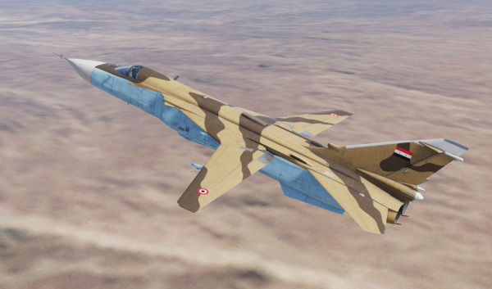
Other critical targets
Airfields:
Runways:
Airfield out of operation for 24-48 hours
Depending on the amount of damage inflicted
Ammunition storage:
Certain types of ammunition unavailable
Sortie rates reduced
Depending on the amount of damage inflicted
Fuel:
Sortie rates reduced until able to resupply
Depending on the amount of damage inflicted
Aircrafts:
- Destruction of aircraft will reduced the capability of the squadron as they have fewer aircraft available
A
A
B
B
C
C
D
D
E
E
F
F
Back

Slide 14
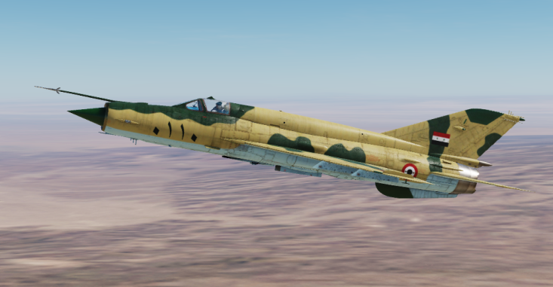
Mission type capability
Fighter squadrons conduct the following mission sets:
- Sweep
CAP
Limited form of escort
Interceptor squadrons are based at airfields and tied to Notian IADS and supports as Quick Reaction Alert flights to protect Notian airfields from attack.
Assault Aviation squadrons conduct the following mission sets:
CAS (with ground forces in static positions)
AR
AI
Bomber Squadrons conduct the following mission sets:
AI
Strikes
Heavy Bomber Squadrons
Naval Fighter Squadrons
Maritime Strike Squadrons
Maritime Patrol Squadrons
A
A
B
B
C
C
D
D
E
E
F
F
Back

Slide 15
INTELLIGENCE GAPS
Provide a list of questions or gaps in intelligence, where taskings can be generated to collect information
What are the reaction time of QRA fighters?
Are the reaction time the same for all airfields with QRA stationed (interceptors)
INSERT MAP HERE
A
A
B
B
C
C
D
D
E
E
F
F
Back

